Slide 1
MLL Phase Contrast Line Profiles
Anders F. Pedersen
13-03-2017

Slide 2
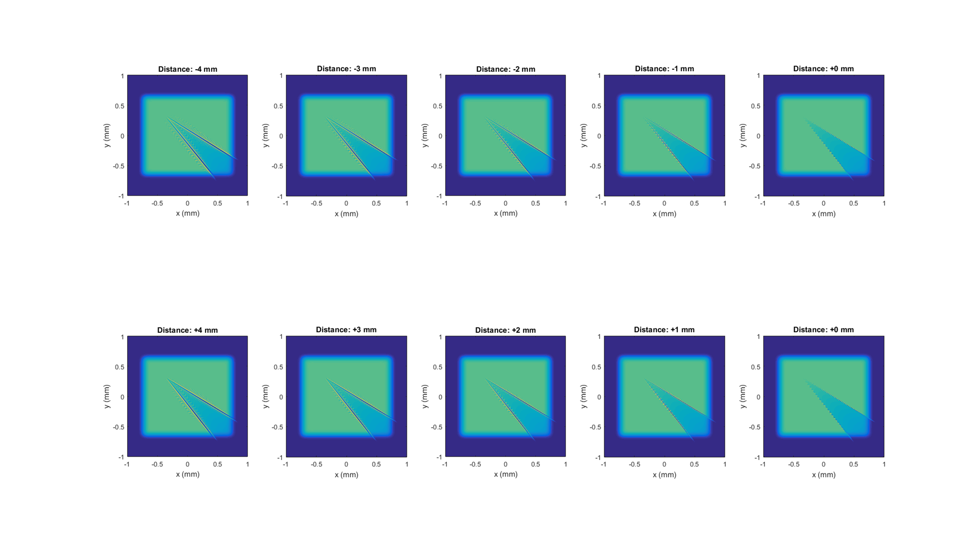
All simulated images

Slide 3
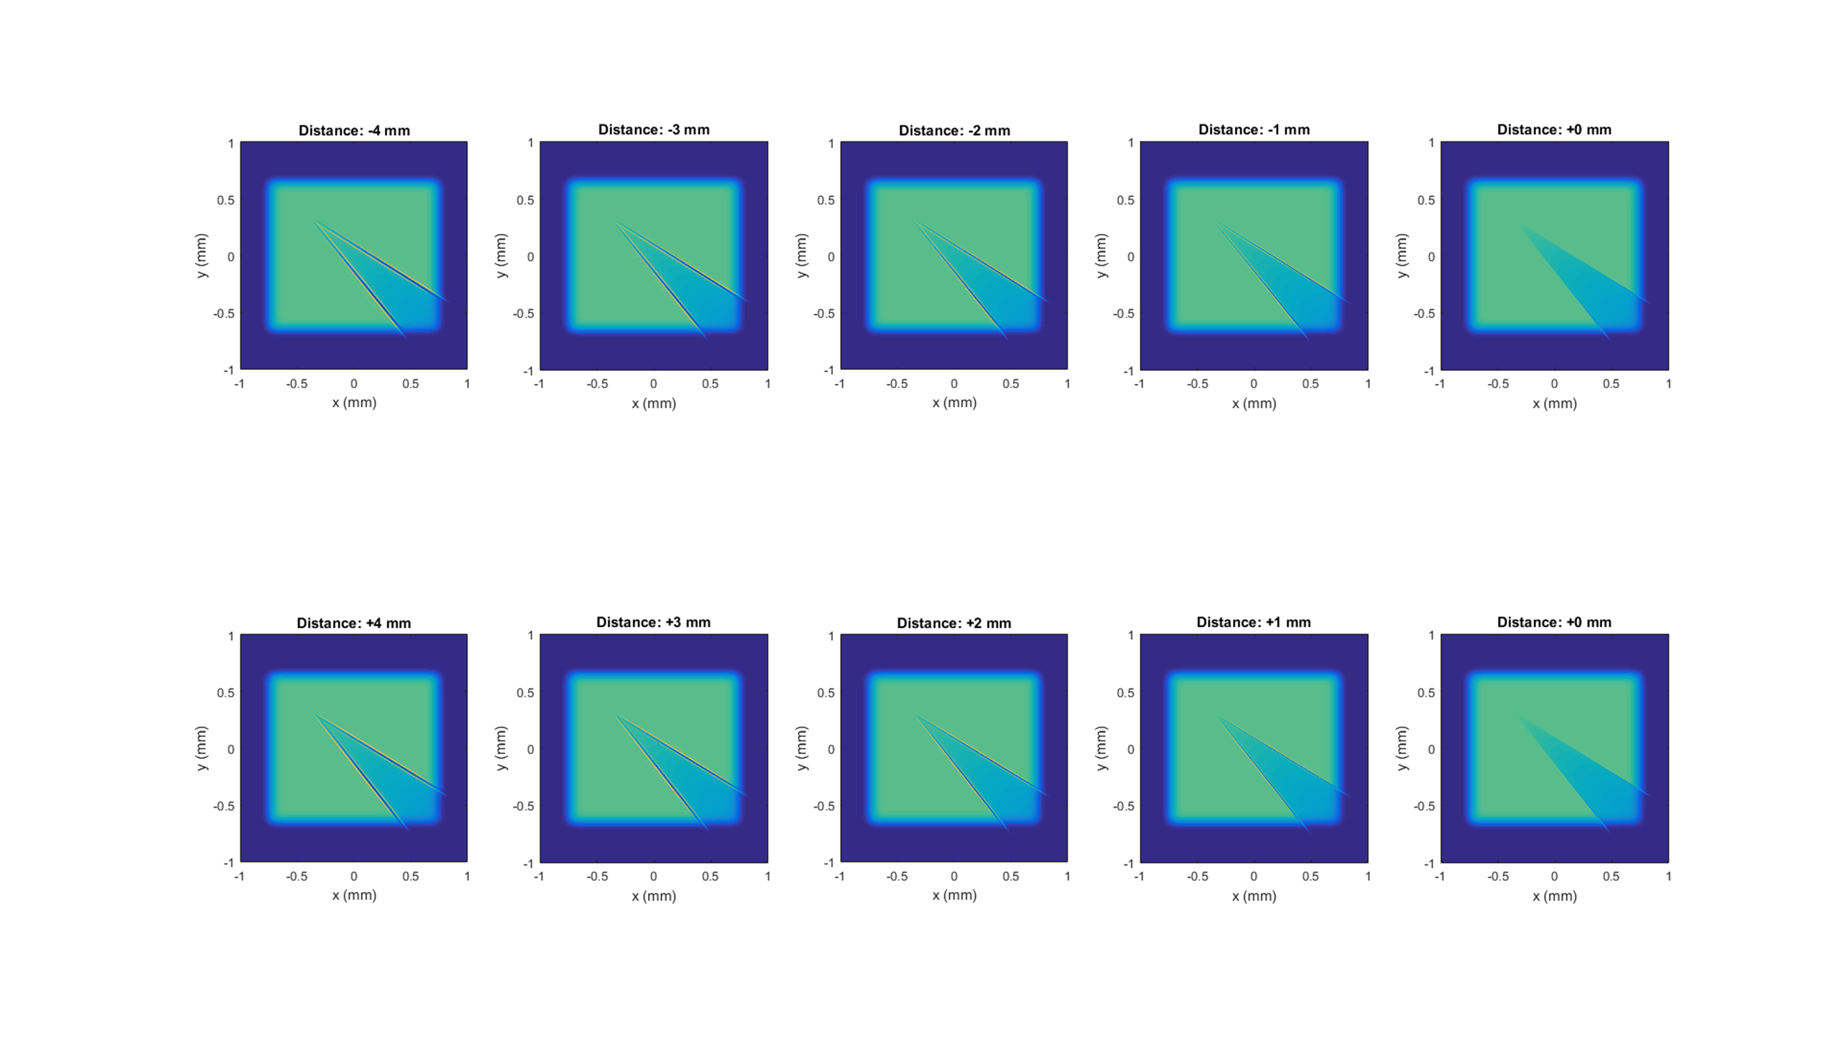
All images after convolution with Gaussian point spread function (FWHM 100 nm in object space)

Slide 4
This is where the line profile is evaluated

Slide 5
Increasing object-lens distance

Slide 6
Decreasing object-lens distance

Slide 7
Lens moved ±1 mm

Slide 8
Lens moved ±2 mm

Slide 9
Lens moved ±3 mm

Slide 10
Lens moved ±4 mm

